Slide 1
A HOLODESK FOR DUNG BEETLES
BY
HAIDI HU
SIJIA CHENG
XI CHEN
XINGDA LI

Slide 2
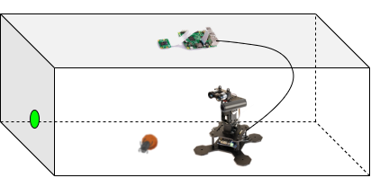
Aim of the Project
Simulate the sun for dung beetles in an enclosed room
Construction of the 3D model of the room
Mapping between 2D camera and 3D LIDAR
Redirect the dung beetle with laser
Tools: Arbotix-M, Raspberry Pi with Pi camera, Servo motors, LIDAR, Laser and dung beetle
Figure 1. Schematic of the setup in real scenario

Slide 3
Collaboration
Contributions of each of us to this project are specified in the table below
HAIDI HU | Redirecting the dung beetle with laser
SIJIA CHENG | Construction of the 3D model of the room
XI CHEN | Mapping algorithm and implementation, Evaluation of the system
XINGDA LI | Communication between Pi and MC, Mapping algorithm and implementation

Slide 4
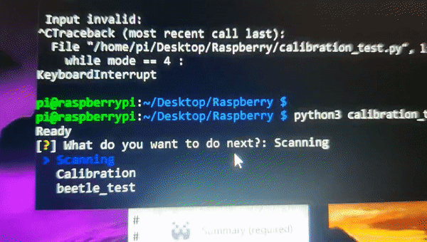
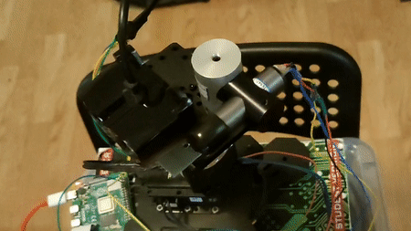
Implementation
Construction of the 3D model of the room
The pan of Lidar goes between 0° and 360° back and forth
When reaching 0° or 360°, the angle of elevation increases a certain value
The uC sends measurements(pan, tilt, distance) to Raspberry Pi via serial communication
Figure 2. Behavior of the system during room scanning

Slide 5
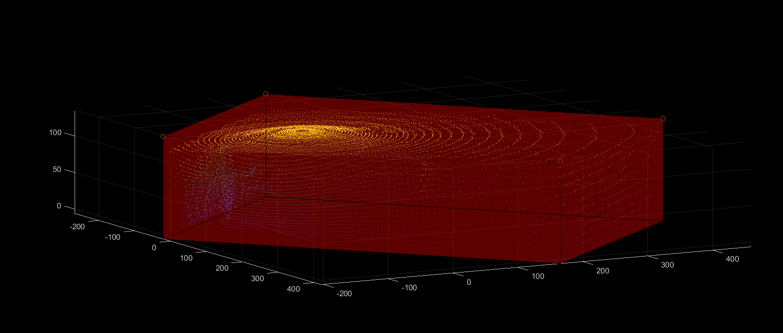
Implementation
Construction of the 3D model of the room
The pan of Lidar goes between 0° and 360° back and forth
When reaching 0° or 360°, the angle of elevation increases a certain value
The MC sends measurements(pan, tilt, distance) to Raspberry Pi via serial communication
Figure 3. 3D plot of the points cloud from room scanning

Slide 6
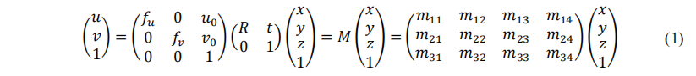
Implementation
Mapping between 2D camera and 3D LIDAR
Transform from a 2D point (u,v) to a 3D point (x,y,z) linearly
Solve linear equations using the singular value decomposition (SVD) method
Feed several correspondence pairs to obtain M
where fu and fv are the effective focal lengths in horizontal and vertical directions, respectively, and (u0, v0) is the center point of the image plane. R and t are the rotation and the translation matrices.[1]
[1] Park, Yoonsu & Yun, Seokmin & Won, Chee & Cho, Kyungeun & Um, Kyhyun & Sim, Sungdae. (2014). Calibration between Color Camera and 3D LIDAR Instruments with a Polygonal Planar Board. Sensors (Basel, Switzerland). 14. 5333-5353. 10.3390/s140305333.

Slide 7
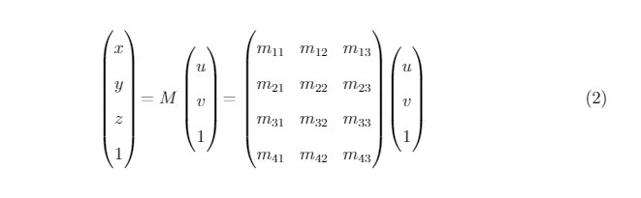
Implementation
Mapping between 2D camera and 3D LIDAR
Transform from a 2D point (u,v) to a 3D point (x,y,z) linearly
Solve linear equations using the singular value decomposition (SVD) method
Feed several correspondence pairs to obtain M

Slide 8
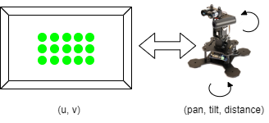
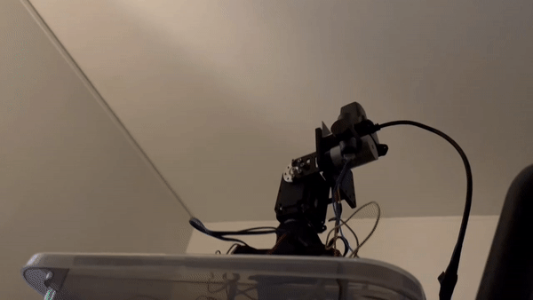
Implementation
Take N 3D points from point clouds
Feed pan and tilt to the servos
Detect the 2D position of the laser spot
Iterate until N correspondence pairs
Calculate M
Figure 4. Behavior of the system during mapping

Slide 9
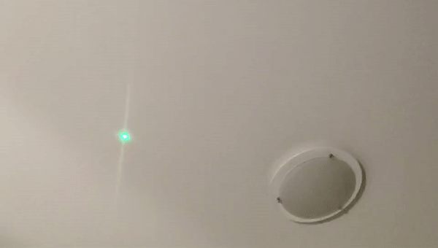
Implementation
Redirect the dung beetle with laser
Get the location of the beetle in the image using camera
Convert it to the position in the 3D map using M matrix
Recalculate the position of all points in the 3D cloud map with the beetle's movement direction as the positive X axis
Take out the points we want and send the pan&tilt data to the motor
Figure 5. Keeping the direction of the “dung beetle” constant

Slide 10
Evaluation
Test the system with a random pattern, ie. position and desired direction
No | start_location(cm) | end_location(cm) | time(ms)
1 | [47,-129,167] | [125,573,42] | 9442
2 | [125,573,42] | [22,32,169] | 3298
3 | [22,32,169] | [-13,20,172] | 3091
4 | [-13,20,172] | [-91,-28,173] | 3304

Slide 11
Evaluation
Test the system with a constant pattern(Dung beetle walks in a straight line y = x)
No | start_location(cm) | end_location(cm) | time(ms)
1 | [10,16,172] | [20,27,169] | 327
2 | [20,27,169] | [30,33,170] | 345
3 | [30,33,170] | [40,46,169] | 317
4 | [40,46,169] | [50,63,172] | 326

Slide 12
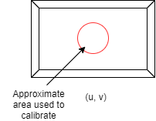
Evaluation
Evaluate the errors of the mapping
Feed six more pan and tilt values to servos after having M
Detect the 2D position of the laser spot and get the corresponding 3D point
Calculate the distance between actual 3D point and the mapped one
NO. | 1 | 2 | 3 | 4 | 5 | 6
Error(cm) smaller area | 1.8198 | 1.6297 | 1.2211 | 0.8160 | 0.8710 | 1.3383
Error(cm) bigger area | 6.0012 | 2.8394 | 2.2814 | 1.5990 | 1.3283 | 1.9129
Figure 6. The area used to do calibration and evaluation

Slide 13
Future work
Algorithm to find the roof (or floor) area
Maybe do the mapping with all (or most) points on roof (or floor)
Update the solution from mapping by using a nonlinear least squares method
Algorithm to determine the desired direction of the dung beetle

